Slide 1
KA229
GLOBAL CITIZENSHIP
“Exchange of goods practices”

Slide 3
Partners:
Dukdalf (Netherlands)
Scoala Gimnaziala Altina (Romania)
Scoala Gimnaziala “Ion Luca Caragiale” (Romania)
Agrupamento de Escolas do Barreiro (Portugal)
IES “Miguel Hernández” (Spain)

Slide 4
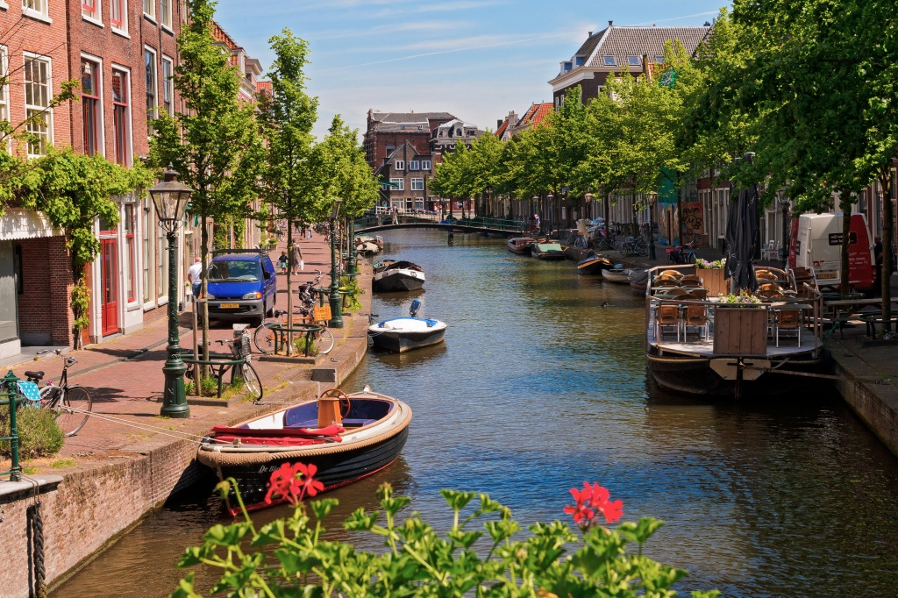
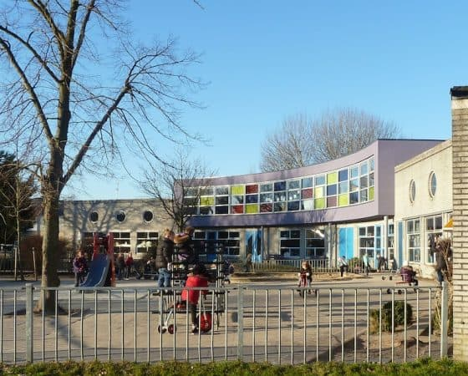
Dukdalf (Netherlands)
Leiden
122000 inhabitants
Primary level

Slide 5
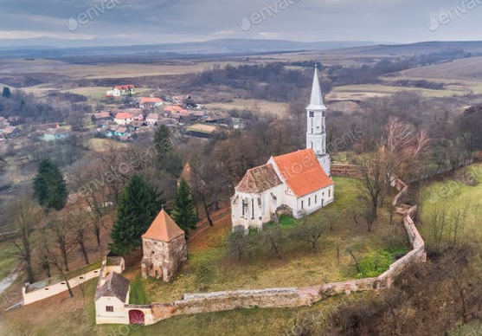
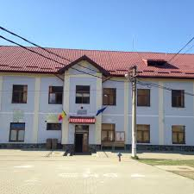
Scoala Gimnaziala Altina (Romania)
Altina
1700 inhabitants
Primary and Secondary level

Slide 6
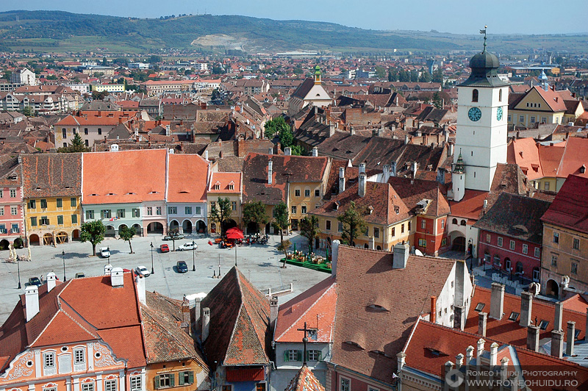
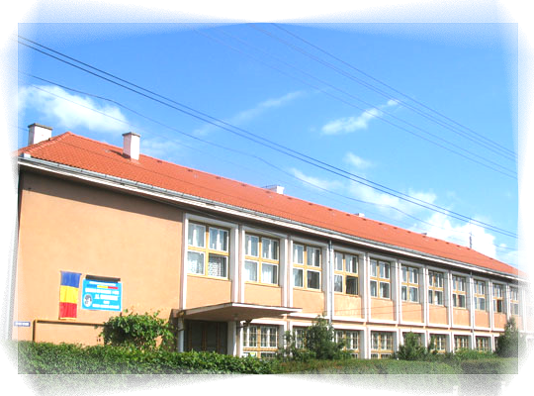
Sócala Gimnaziala “Ion Luca Caragiale”
Sibiu
147000 inhabitants
Primary and Secondary level

Slide 7
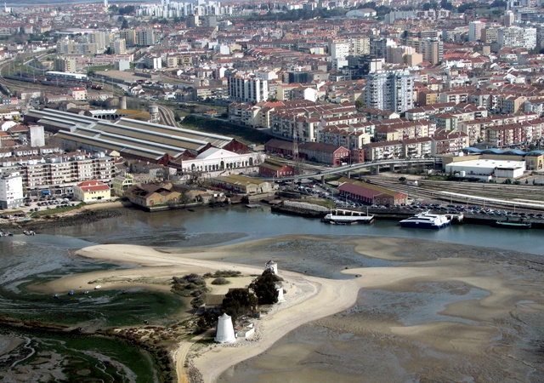
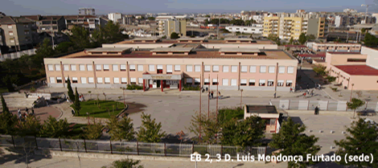
Agrupamento de Escolas do Barreiro
Barreiro
77800 inhabitants
Primary level

Slide 8
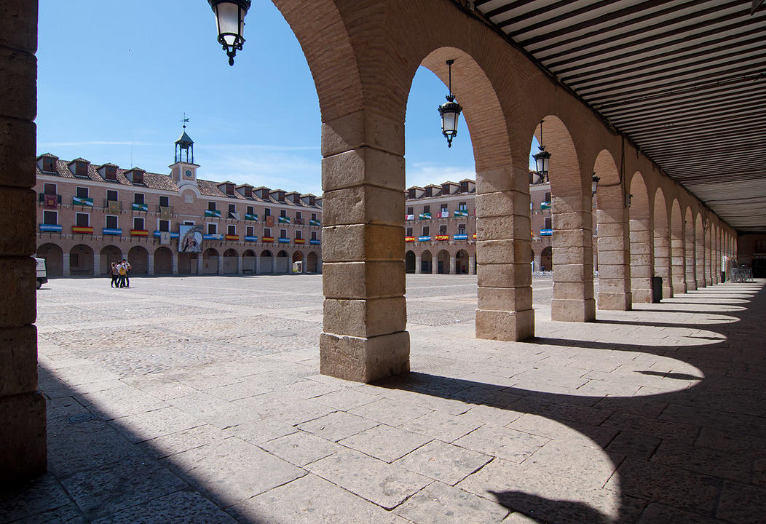
IES “Miguel Hernández”
Ocaña
10700 inhabitants
Secondary level

Slide 9
Meetings:
Leiden (11 / 2018)
Barreiro (2 / 2019)
Sibiu (9 / 2019)
Altina (2 / 2020)
Ocaña (4 / 2020)

Slide 10
Thank you!

